Slide 1









NED UNIVERSITY OF ENGINEERING & TECHNOLOGY
SMART ROUTE
FINDING THE BEST WAY TO NED
Submitted to
DR. USman amjad

Slide 2
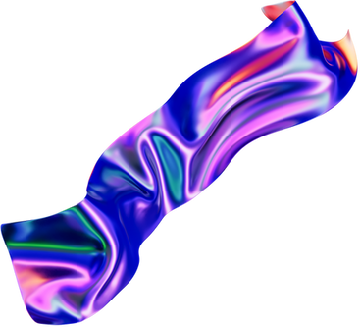



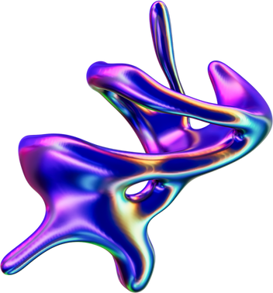

INTRODUCTION
In a city as complex as Karachi, daily commuting can be a challenge — especially when choosing the most efficient route.
This project aims to optimize travel for four individuals starting from North Nazimabad, North Karachi, Gulshan-e-Iqbal, and Water Pump, all heading to NED University.
With four possible entry gates and varying traffic patterns, the goal is to determine the shortest and fastest path for each person using different search algorithms.
By modeling Karachi as a graph, we analyze and compare DFS, BFS, Dijkstra’s, and A* algorithms to make intelligent gate recommendations.

Slide 3

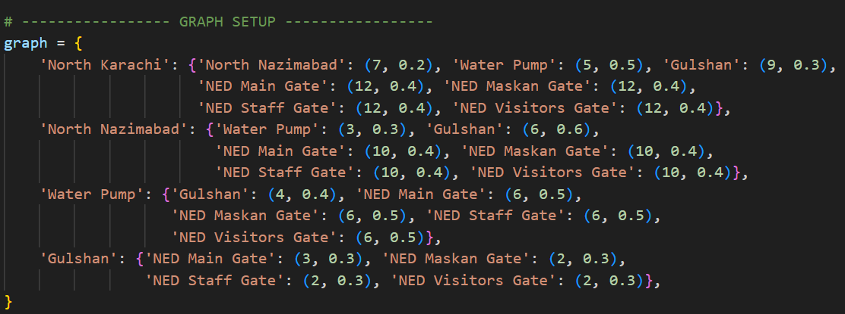

MODULAR OVERVIEW OF THE ROUTING ALGORITHM IMPLEMENTATION
1- graph modeling
The city map is modeled as a weighted graph using a Python dictionary. Nodes are locations; edges have distance and congestion.

Slide 4
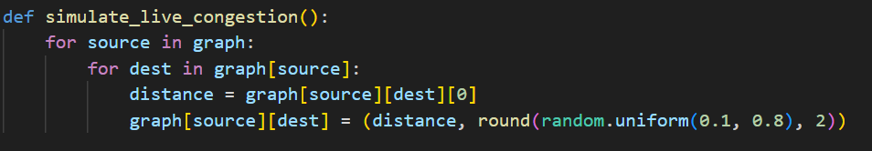
2. Simulating Live Congestion
Random congestion values are generated (between 0.1 and 0.8) to simulate real-time traffic on all roads.

Slide 5
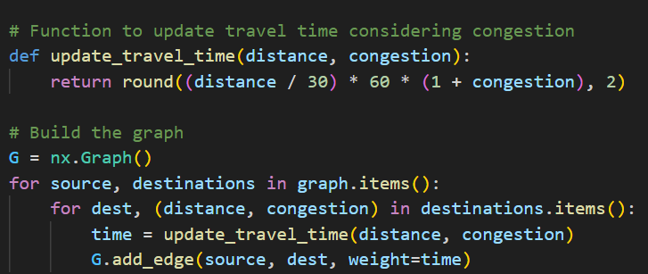
3. Travel Time Calculation
Travel time is calculated dynamically using both distance and congestion, converting it into minutes.

Slide 6
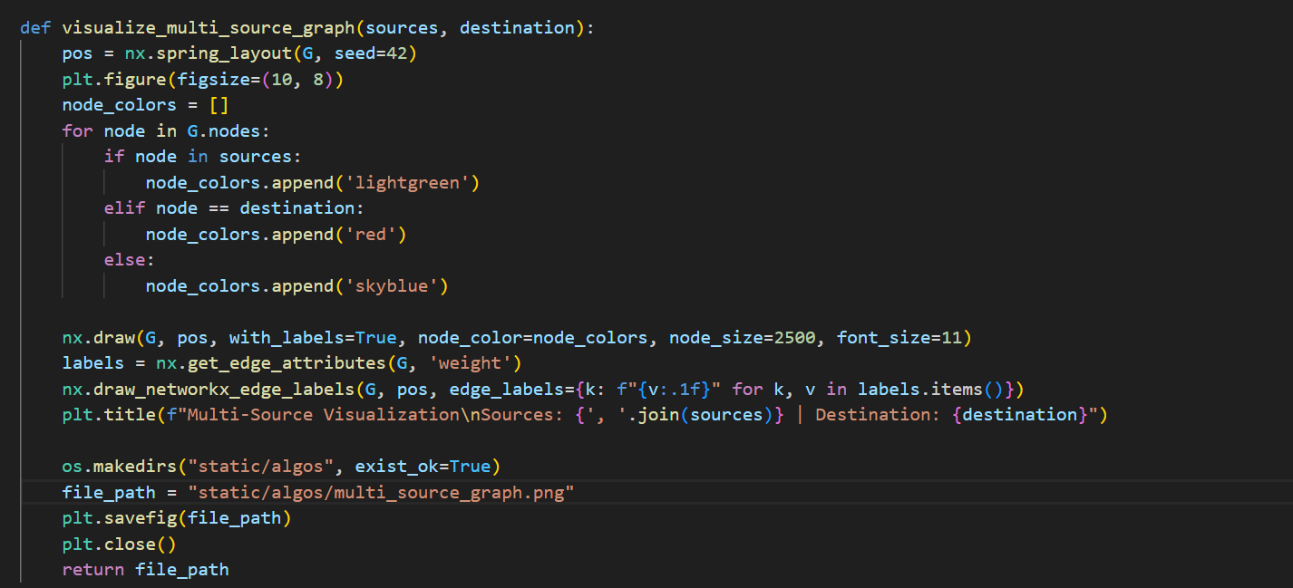
4. Multi-Source Visualization
Highlights multiple source nodes and a single destination, useful for multi-user navigation systems.

Slide 7
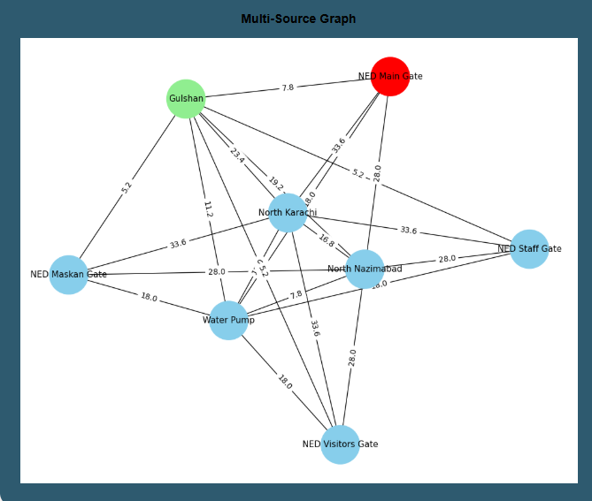
output

Slide 8
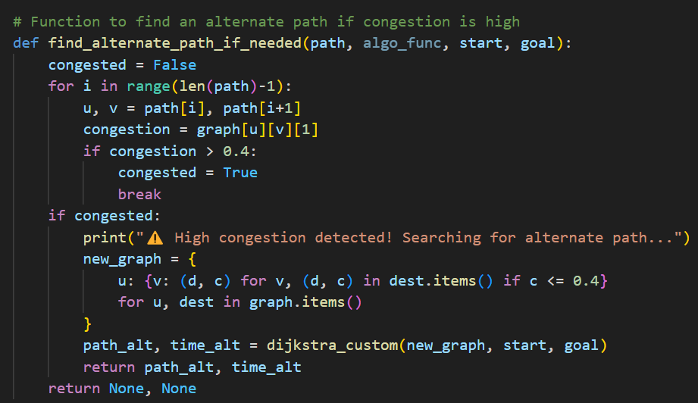
5. Alternate Path Logic
If any segment of the current path has congestion > 0.4, an alternate low-traffic path is found using a filtered graph.

Slide 9

BASIC
ALGORITHMS
01
02
BFS
DFS
Breadth-First Search (BFS) explores the graph level by level, starting from the source node and visiting all its neighbors before moving to the next level. It uses a queue and is ideal for finding the shortest path in unweighted graphs.
Depth-First Search (DFS), on the other hand, explores as far as possible along a branch before backtracking, using a stack (or recursion). It dives deep into one path before exploring alternatives, making it useful for exhaustive searches or path existence checks.

Slide 10
ADVANCED ALGORITHMS
01
02
Dijkstra’s Algorithm
A (A-Star) Search*
Dijkstra’s Algorithm is a popular pathfinding algorithm used to find the shortest path between nodes in a weighted graph. It systematically selects the node with the smallest known distance, updates its neighbors, and continues until the destination is reached. It guarantees the shortest path but can be slower as it checks all possible routes without prioritization.
A (A-Star) Search* builds on Dijkstra’s by adding a heuristic — an estimate of the remaining distance to the goal — to guide the search more intelligently. It balances actual cost from the start with estimated cost to the destination, making it faster and more efficient, especially in large or complex graphs.

Slide 11
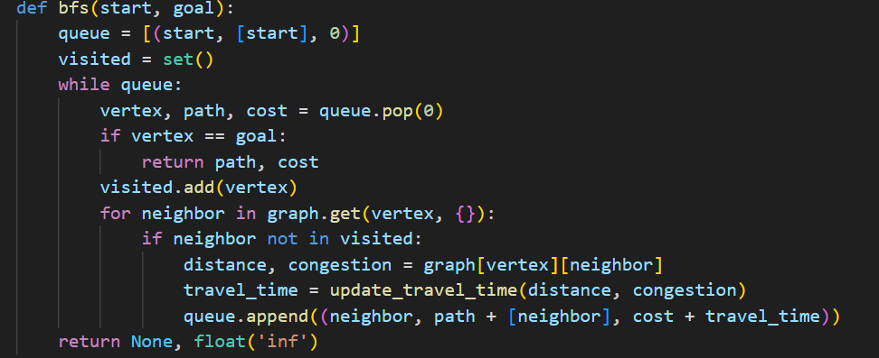
Algorithms Used
1. Breadth-First Search (BFS)
Finds a pth by exploring all neighbors level-by-level. Doesn't consider weights, so it's not optimal for time.

Slide 12
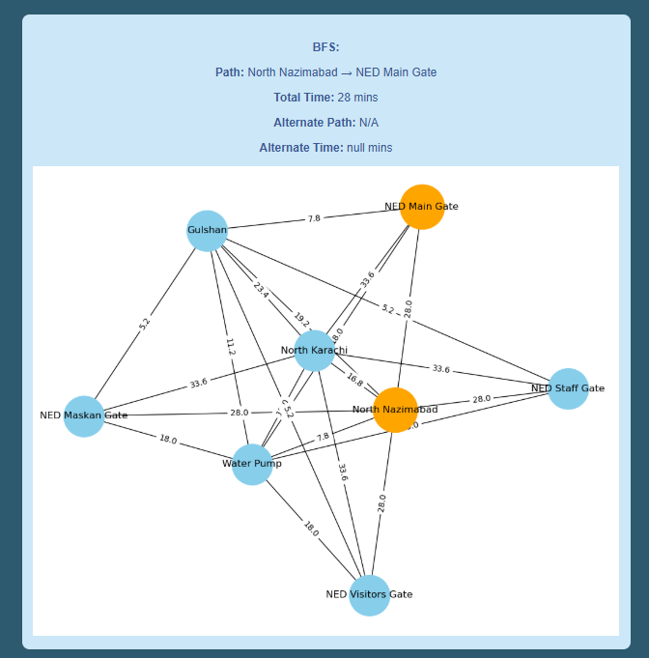
output

Slide 13
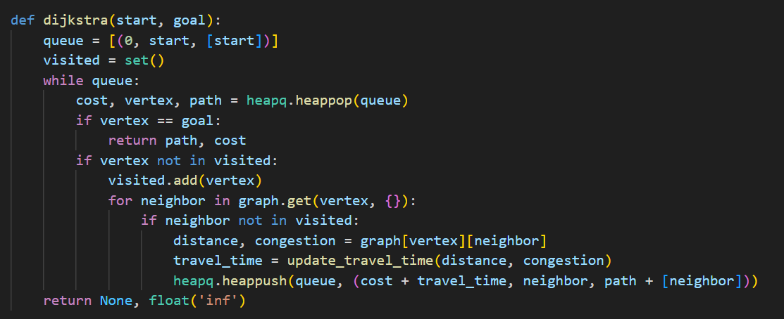
2. Dijkstra’s Algorithm optimization
Finds the shortest-time path using a priority queue. Fully considers congestion-adjusted travel time.

Slide 14
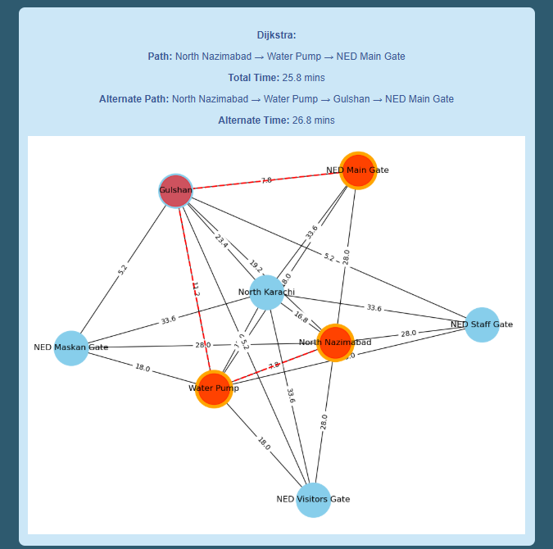
output

Slide 15
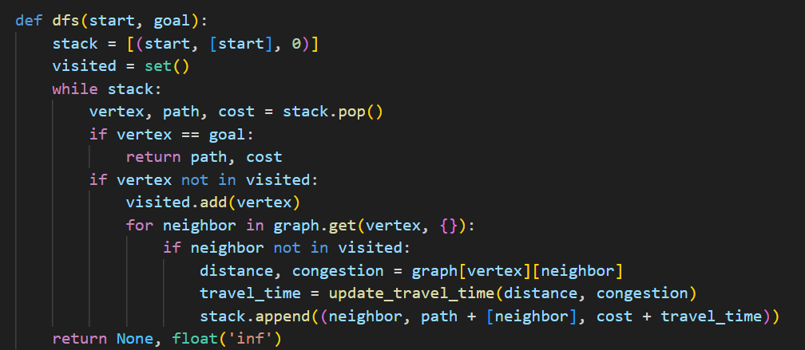
3. Depth-First Search (DFS)
Searches deeply along each path before backtracking. Like BFS, it ignores time/cost optimization.

Slide 16
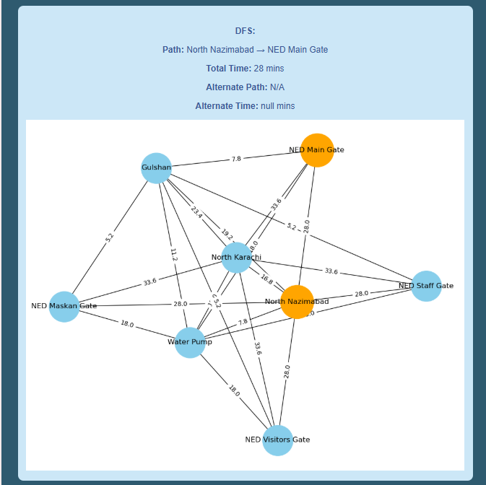
output

Slide 17
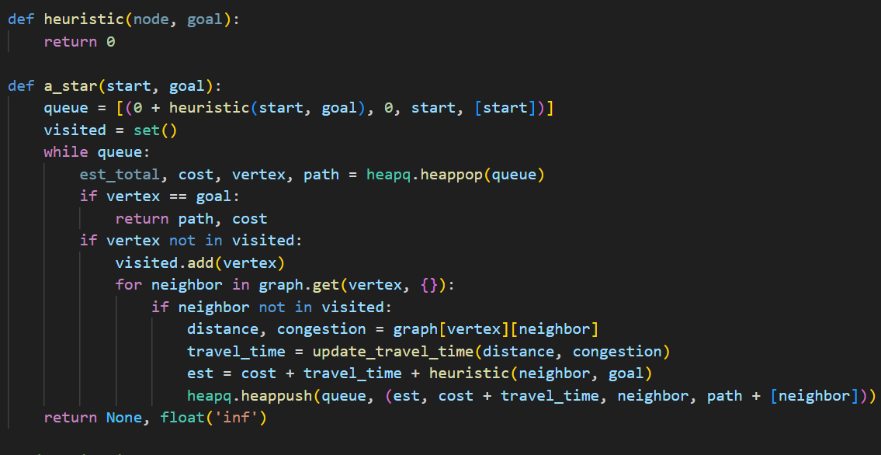
4. A Search Algorithm*
Uses cost plus a heuristic to predict best path. Currently, the heuristic is zero (acts like Dijkstra).

Slide 18
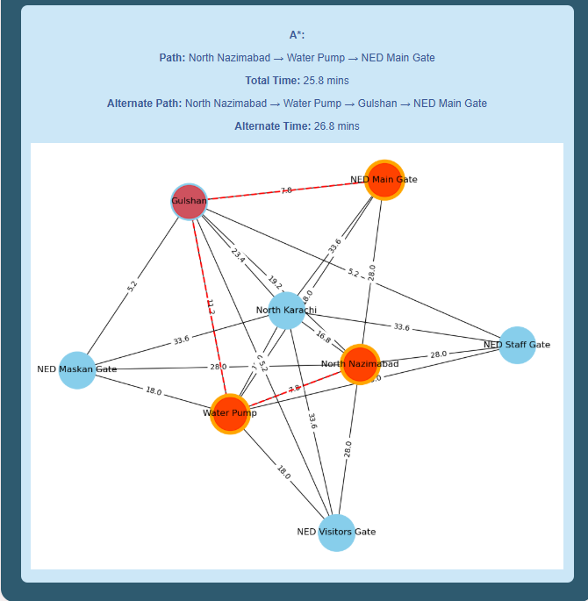
output

Slide 19
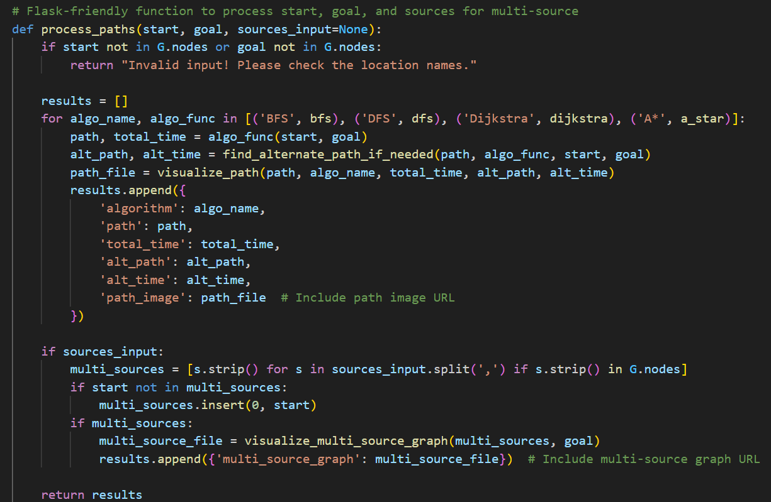
6. Flask Integration
This Flask route processes the start and goal locations, calls the pathfinding algorithms (BFS, DFS, Dijkstra, A*), visualizes the paths, and returns the results to the user.

Slide 20
Comparison of Routing Algorithms: Best Performance
The clear winner here is Dijkstra’s algorithm and by extension A* since its heuristic is zero.
1- Considers True Travel Time
      BFS and DFS ignore edge weights (they treat every step as equal), so they both returned a 28 min route even though faster routes exist.
      Dijkstra and A* explicitly use the congestion‑adjusted travel‑time weights, yielding the true shortest‑time path of 25.8 min.
      2- Guaranteed Optimality
      Dijkstra’s algorithm provably finds the minimum‑cost path in a weighted graph. Neither BFS nor DFS can guarantee that when weights vary.

Slide 21
Comparison of Routing Algorithms: Best Performance
3- Alternate‑Path Handling
      Even when forced into a low‑congestion alternate, Dijkstra’s and A* reroute is 26.8 min, still better than BFS/DFS’s 28 min.
      4- A Equivalence & Extensibility*
      With a zero heuristic, A* degenerates to Dijkstra—so it also finds 25.8 min.
      Why use A*? If you later supply an admissible heuristic (e.g., straight‑line distance), A* can explore far fewer nodes and run faster, while retaining optimality.

Slide 22
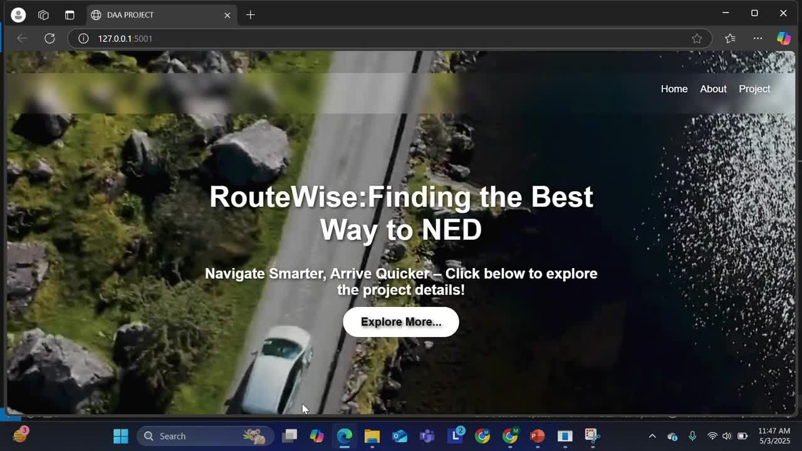

Slide 23
Future Work
● Live Traffic Integration: Incorporate real-time traffic data from APIs like Google Maps or Mapbox.
● Heuristic Optimization for A*: Improve the A* algorithm by integrating geographic heuristics (e.g., Haversine distance).
● User Customization: Let users prioritize shortest distance, lowest congestion, or least time.
● Mobile App Interface: Build a mobile-friendly frontend for commuters.
● Scalability: Extend the system to include more parts of Karachi or other cities.

Slide 24
CONCLUSION
This project presents a congestion-aware routing system using graph algorithms to find the fastest paths in a traffic-affected network. Dijkstra and A* algorithms proved most efficient, accurately minimizing travel time while adapting to congestion. With visualizations and alternate route suggestions, the system offers a smart and practical approach to real-time route planning.

Slide 25
THANKYOU!
Submitted By:
Maham tahir (dt-001)
afifa siddiqui (dt-003)
ashna shaikh (dt-019)
sabrina shahzad (dt-026)

